Slide 1
Capstone Project - 3
Credit Card Default Prediction
ML Supervised Classification
Individual Project:
Soumya Ranjan Mishra

Slide 2
Contents
● Problem Statement
● Data Summary
● Data Analysis
● Analysis Details
● Outlier Treatment
● Feature Selection
● Data Preparation
● Implementing Various Classification Algorithms
● Challenges
● Conclusions

Slide 3

Problem Statements
Predict that customers will default on their credit card payments or not.
Create K-S Chart to evaluate which customers will default on their credit card payments .

Slide 4
Data Summary
Dependent Variable: default payment (Yes = 1, No = 0), as the response variable.
X1: Amount of the given credit (NT dollar): it includes both the individual consumer credit and his/her family (supplementary) credit.
X2: Gender (1 = male; 2 = female).
X3: Education (1 = graduate school; 2 = university; 3 = high school; 4 = others).
X4: Marital status (1 = married; 2 = single; 3 = others).
X5: Age (year).
X6 - X11: History of past payment. We tracked the past monthly payment records (from April to September, 2005) as follows: X6 = the repayment status in September, 2005; X7 = the repayment status in August, 2005; . . .;X11 = the repayment status in April, 2005. The measurement scale for the repayment status is: -1 = pay duly; 1 = payment delay for one month; 2 = payment delay for two months; . . .; 8 = payment delay for eight months; 9 = payment delay for nine months and above.
X12-X17: Amount of bill statement (NT dollar). X12 = amount of bill statement in September, 2005; X13 = amount of bill statement in August, 2005; . . .; X17 = amount of bill statement in April, 2005.
X18-X23: Amount of previous payment (NT dollar). X18 = amount paid in September, 2005; X19 = amount paid in August, 2005; . . .;X23 = amount paid in April, 2005.

Slide 5
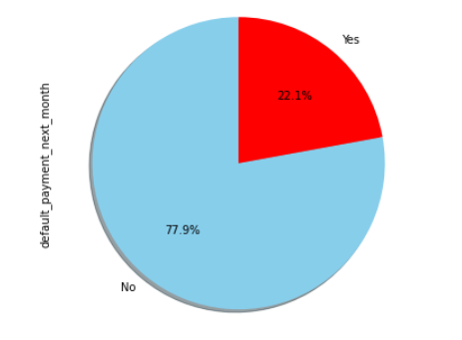
Basic Data Exploration
● The dataset has 30000 rows and 25 features(columns).
● No categorical features as encoding done before.
● Outliers present
●No Missing Values.
● No Duplicated values.
● No null values.
● Imbalanced Dataset as “No” count is 23364 as 77.88% and “Yes” count is 6636 as 22.12% of the whole dataset.

Slide 6
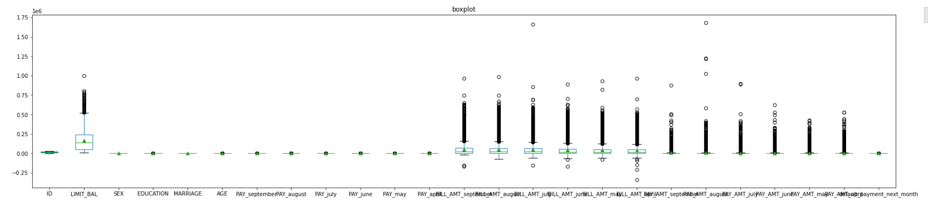
Outliers in the features

Slide 7
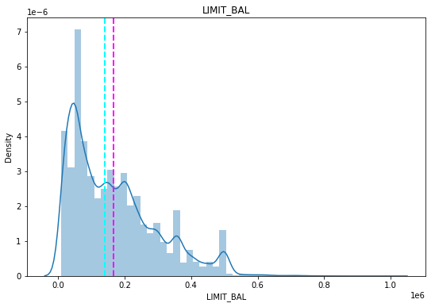
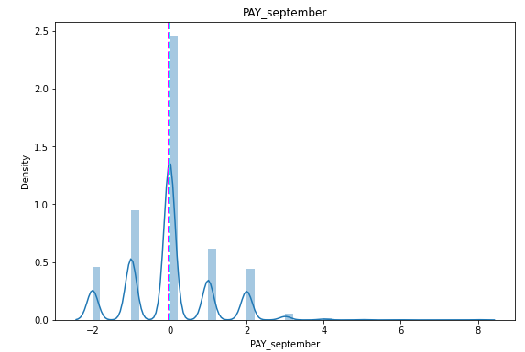
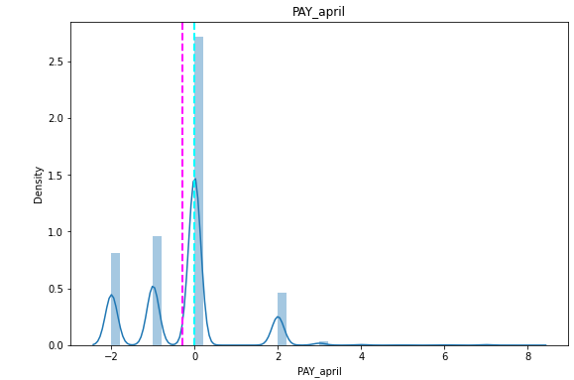
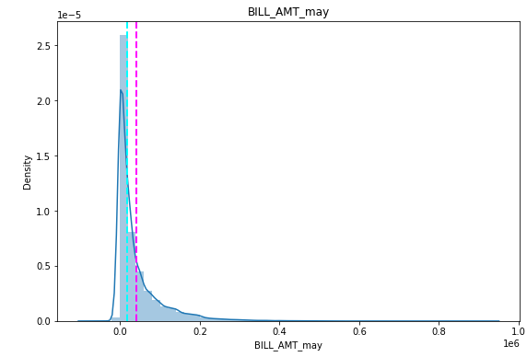
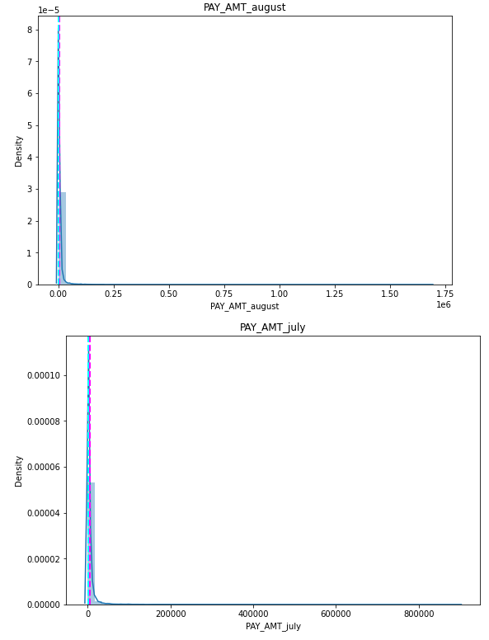
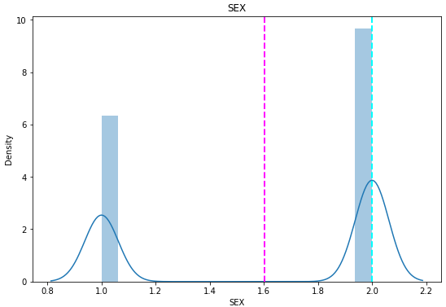
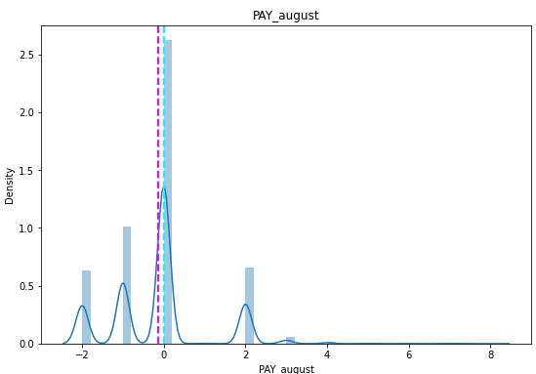
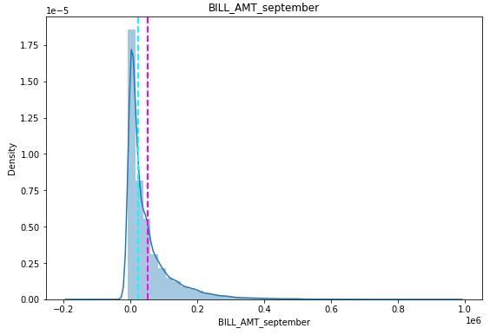
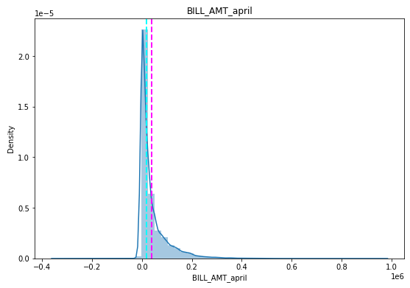
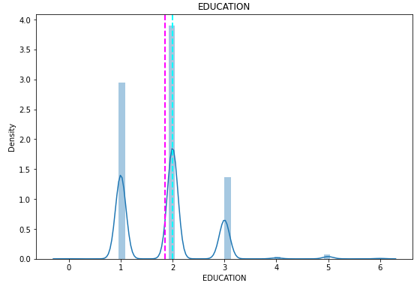
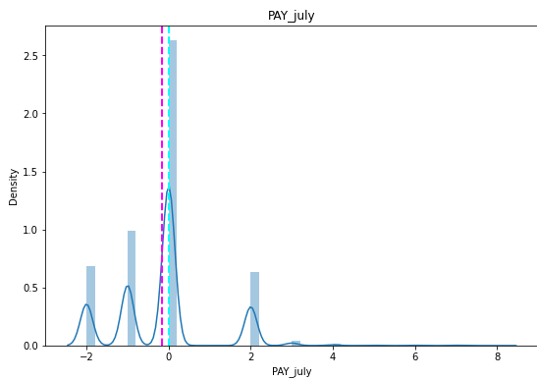
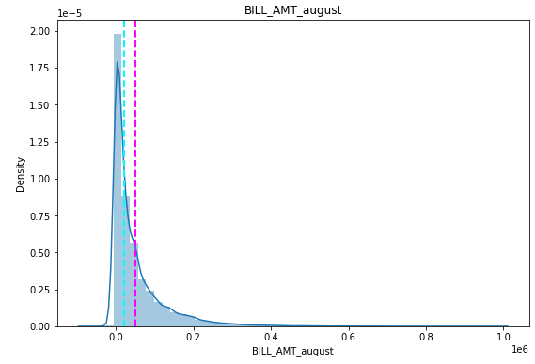
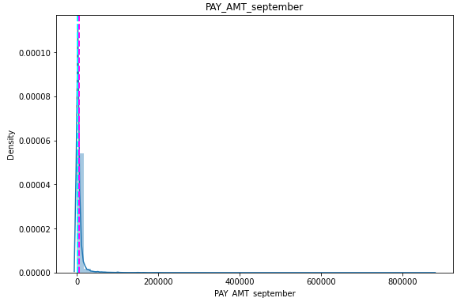
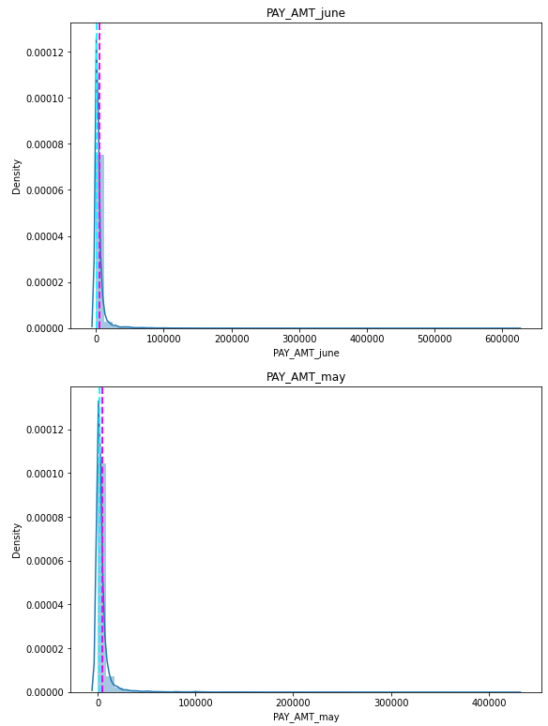
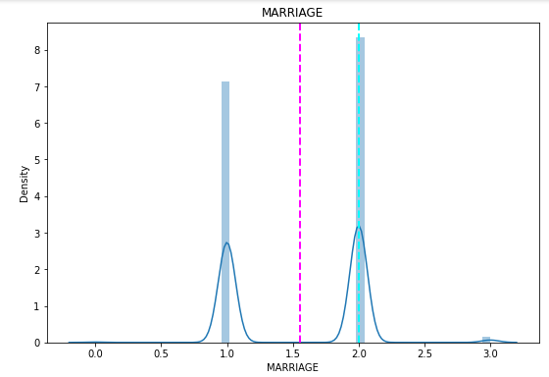
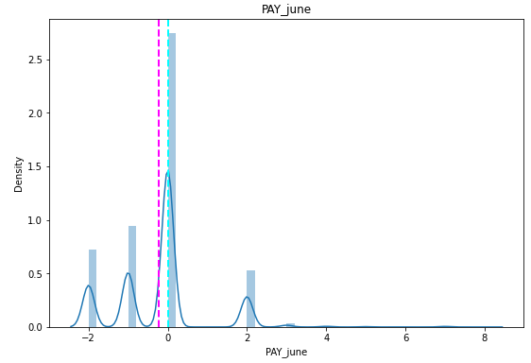
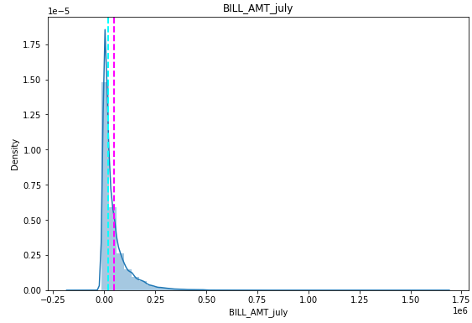
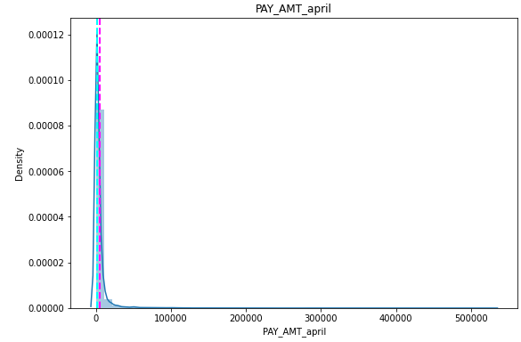
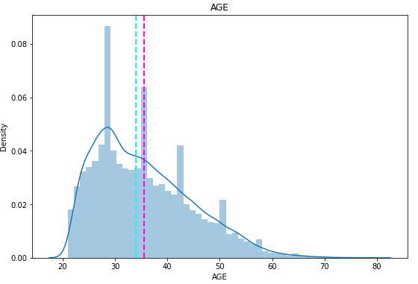
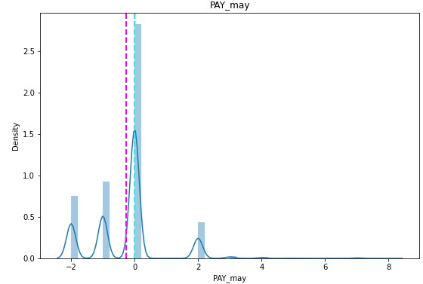
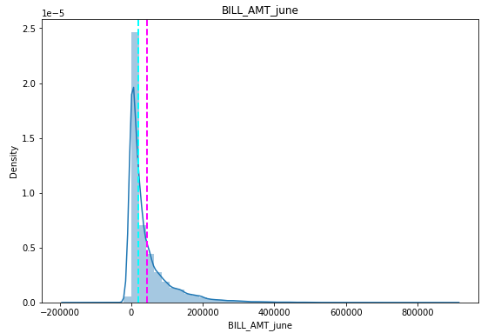
Mean Distribution of Various Features

Slide 8
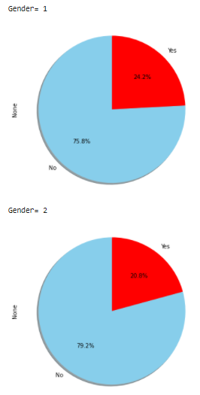
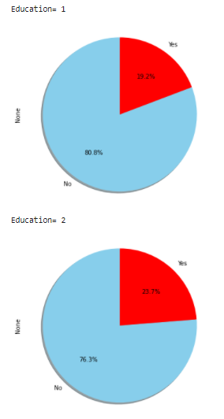
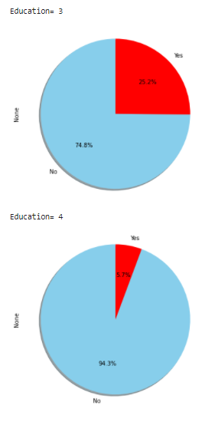
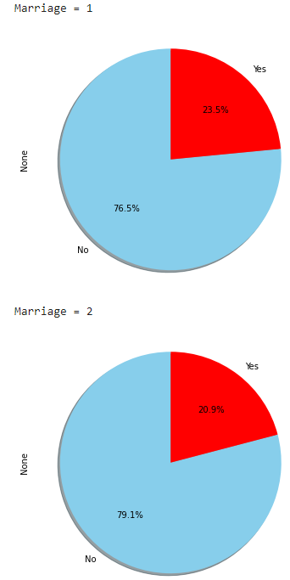
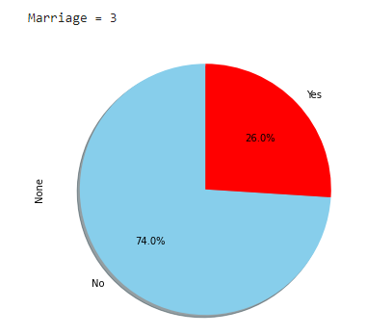
Distribution of Gender, Education , Marital Status

Slide 9
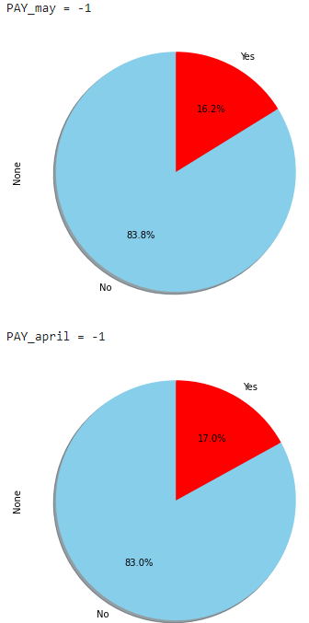
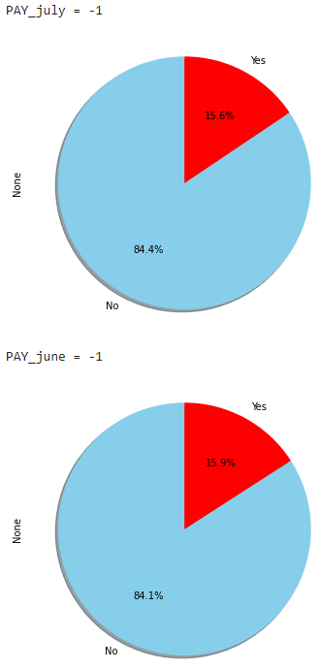
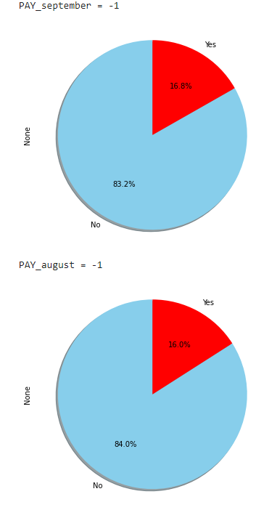
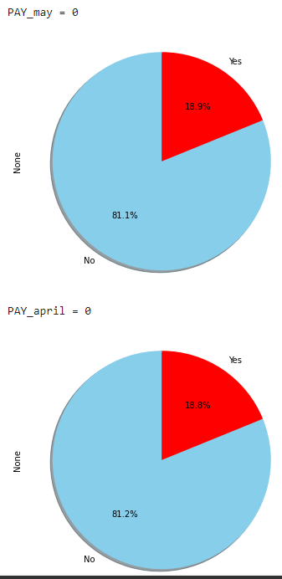
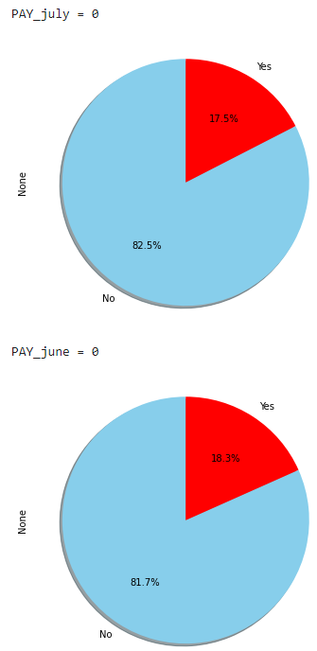
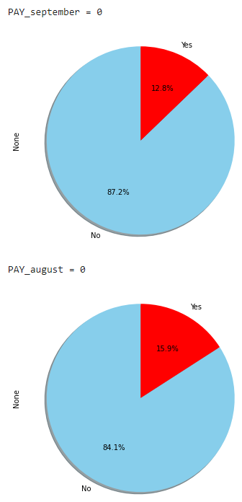
Distribution of PAY_X

Slide 10
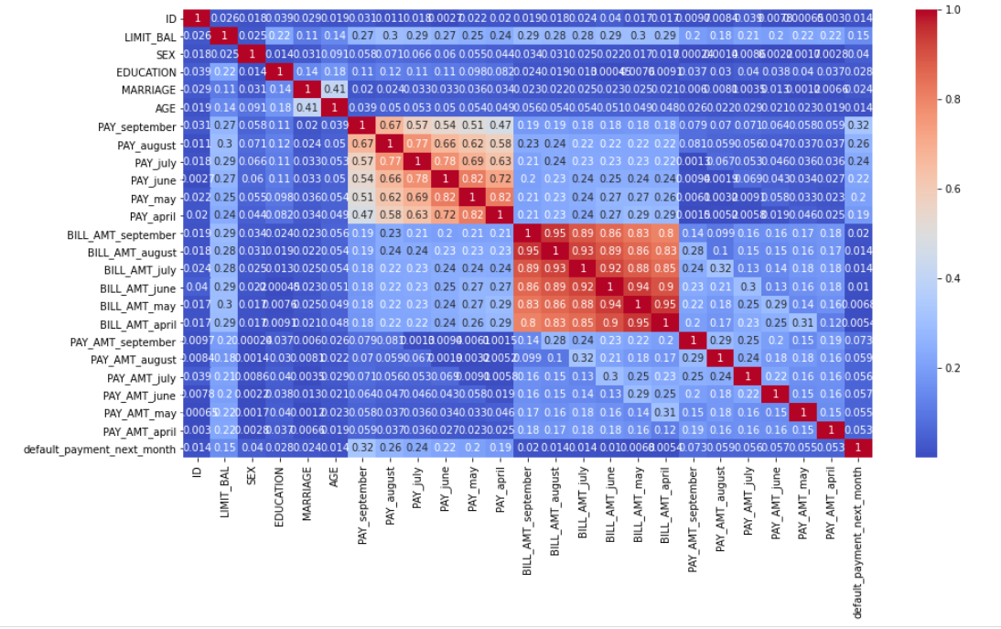
Correlation Matrix

Slide 11
Analysis Details
Defaults have a higher proportion of Lower LIMIT_BAL values
NonDefaults have a higher proportion of Females (Sex=2)
NonDefaults have a higher proportion of More Educated (EDUCATION=1 or 2).
NonDefaults have a higher proportion of Singles (MARRIAGE=2)
NonDefaults have a higher proportion of people 30-40years
NonDefaults have a MUCH higher proportion of zero or negative PAY_X variables (this means that being current or ahead of payments is associated with not defaulting in the following month).

Slide 12
Outlier Treatment
● For Skewed Features using IQR
● For Quite Symmetric Features using Standard Deviation.

Slide 13
Feature Selection
● Dropping Constant Feature Using Variance Threshold
● Feature Selection with Pearson Correlation

Slide 14
Data Preparation
Handling Imbalance set by Synthetic Minority Oversampling Technique (SMOTE)
● Train Test Split (test_size=0.3, random_state=0)

Slide 15


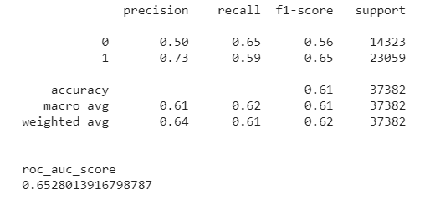
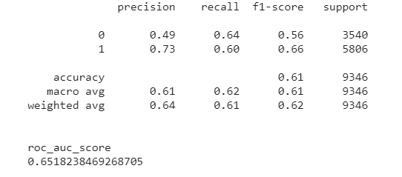
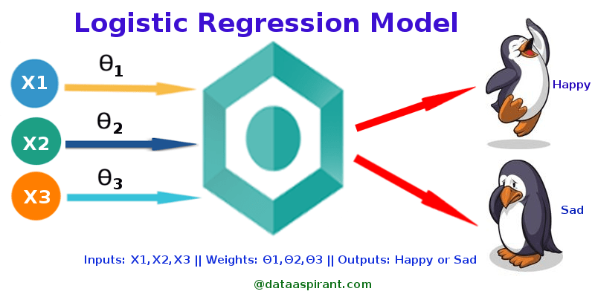
Logistic Regression Train Set Metrics Test Set Metrics

Slide 16


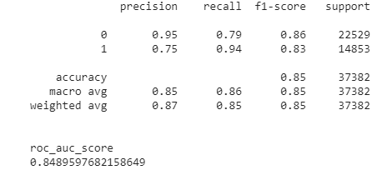
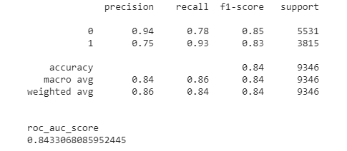
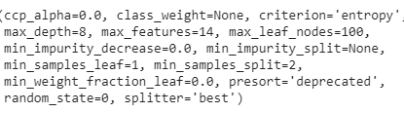
Decision Tree
Train Set Metrics Test Set Metrics
Hyper parameter

Slide 17
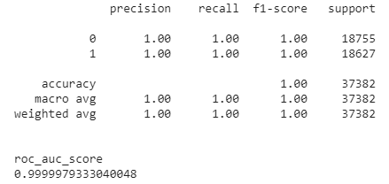
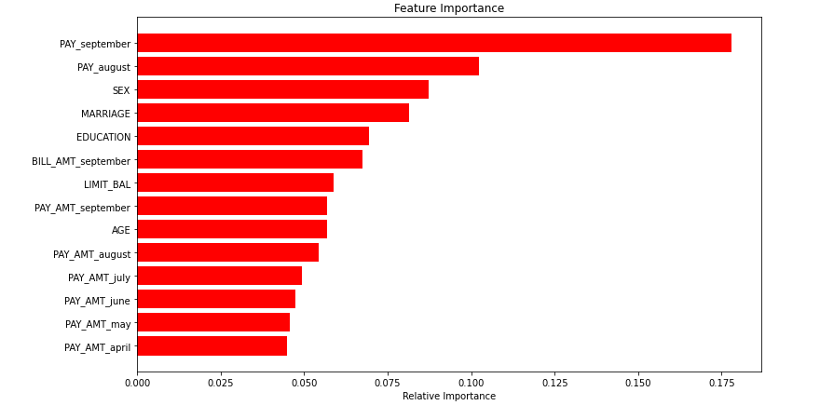


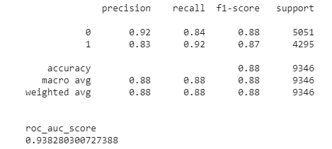

Random Forest
Train Set Metrics Feature Importance
Test Set Metrics
Hyper parameter

Slide 18
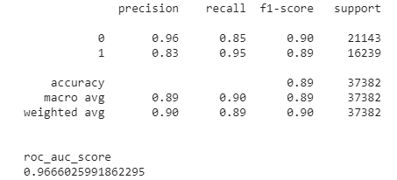

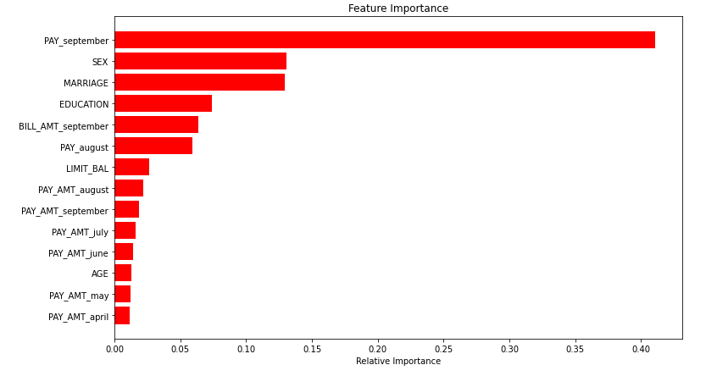
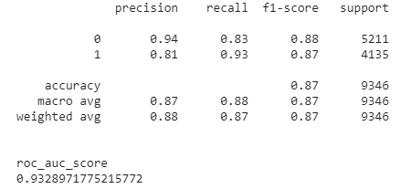


Gradient Boosting Machine
Train Set Metrics Feature Importance
Test Set Metrics
Hyper parameter

Slide 19

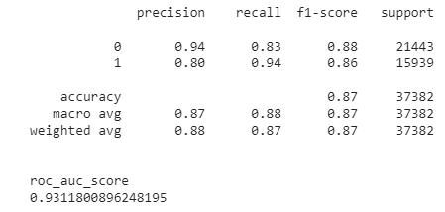
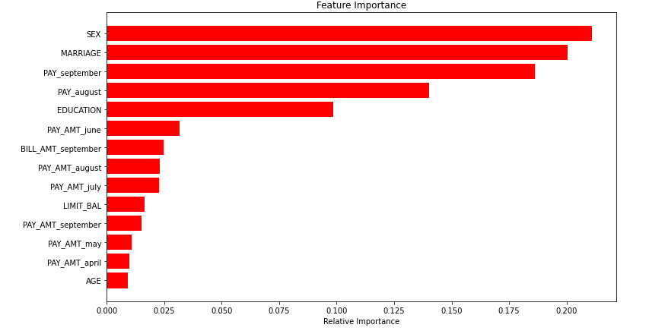



XGBoost
Train Set Metrics Feature Importance
Test Set Metrics
Hyper parameter

Slide 20

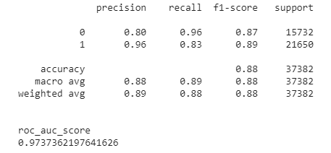



K-Nearest Neighbour
Train Set Metrics Test Set Metrics

Slide 21








Support Vector Machine
Train Set Metrics Test Set Metrics
Naïve Bayes Classification
Train Set Metrics Test Set Metrics

Slide 22

K-S Chart

Slide 23
Challenges
Large Dataset to handle.
Needs to plot lot of Graphs to analyse.
Carefully handled Feature selection part .
Carefully tuned Hyper parameters.
Handled the imbalanced Dataset carefully.

Slide 24
Conclusion
No overfitting is seen.
Random Forest gives the highest ROC_AUC score, Accuracy & F1 Score of 99.9%,100% & 100% respectively for Train Set and 93.8%, 88% & 88% respectively for Test set.
Feature Importance value for Random Forest, Gradient Boost, and XGBoost are different.
KS is 90.1% at decile 3.
We can deploy this model.

Slide 25
THANK YOU Q & A

